Slide 1

Habakkuk’s Prayer
Habakkuk 3:3-4, 10-11, 17-19

Slide 2

³ His glory covered the heavens and his praise filled the earth. ⁴ His splendor was like the sunrise; rays flashed from his hand, where his power was hidden

Slide 3
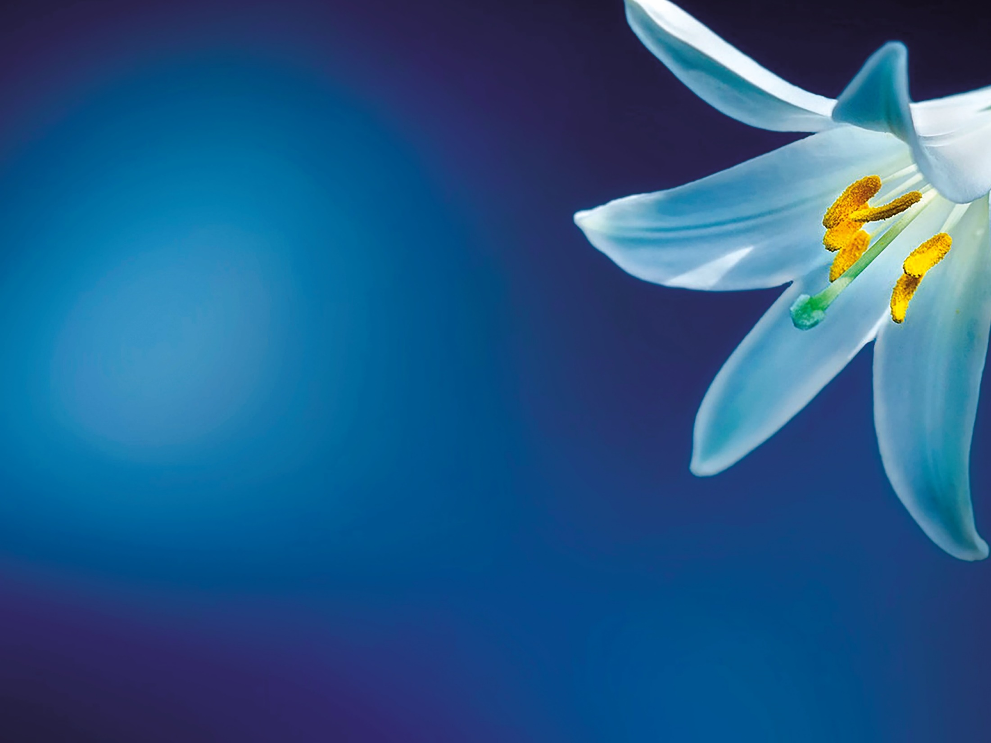
¹⁰ the mountains saw you and writhed. Torrents of water swept by; the deep roared and lifted its waves on high.

Slide 4
¹¹ Sun and moon stood still in the heavens at the glint of your flying arrows, at the lightning of your flashing spear.

Slide 5
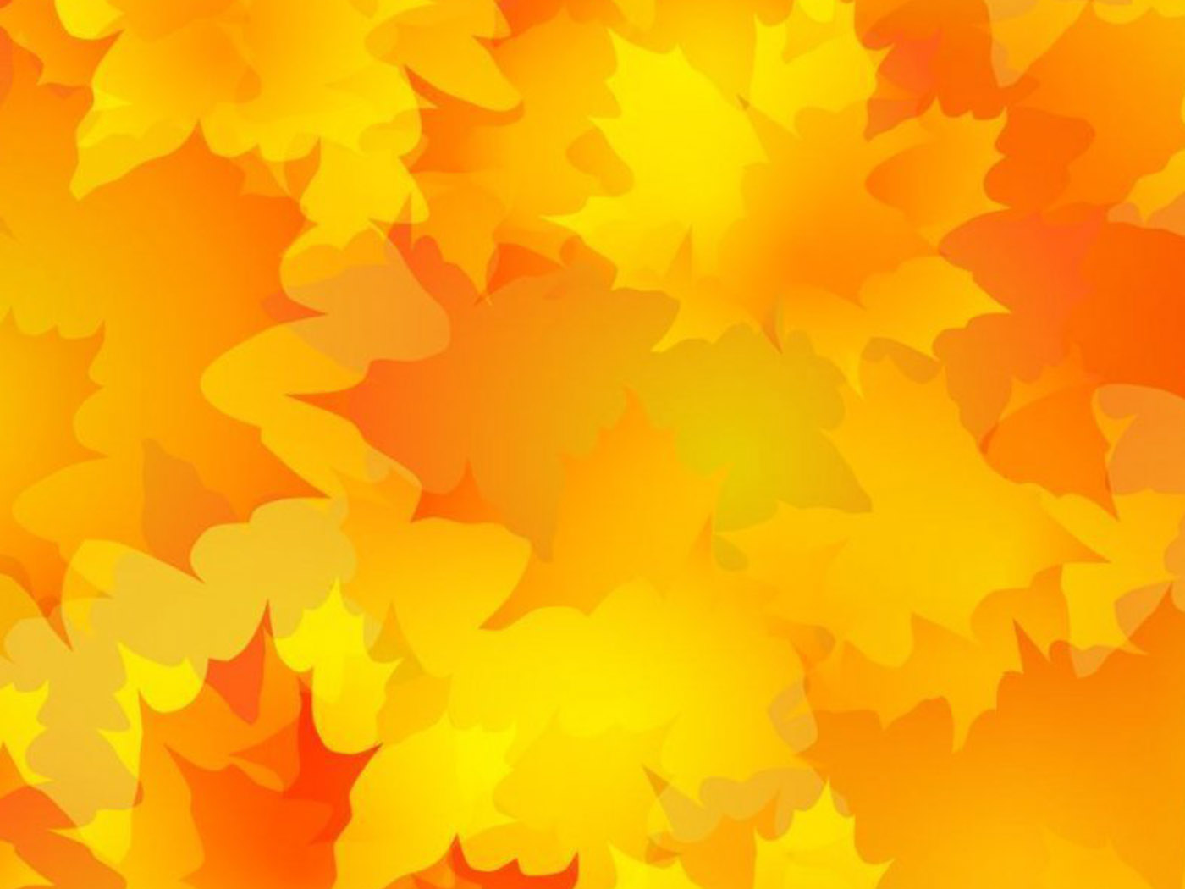
¹⁷ Though the fig tree does not bud and there are no grapes on the vines, though the olive crop fails and the fields produce no food, though there are no sheep in the pen and no cattle in the stalls, –

Slide 6

¹⁸ yet I will rejoice in the Lord, I will be joyful in God my Savior! ¹⁹ The Sovereign Lord is my strength; he makes my feet like the feet of a deer, he enables me to tread on the heights!

